Slide 1
Maths Cafe
Year 3 and Year 4

Slide 2
Maths at St Gregory’s Primary School
In maths each year group must cover the National Curriculum aims and the set programme of study.
We teach the programme of study through a progressive maths scheme named ‘White Rose’ which is also taught in our linked feeder school - St. Wilfred’s Comprehensive.
The scheme along with a range of other resources ensures all pupils are taught a balance of:
Fluency
Reasoning skills
Problem solving skills

Slide 3
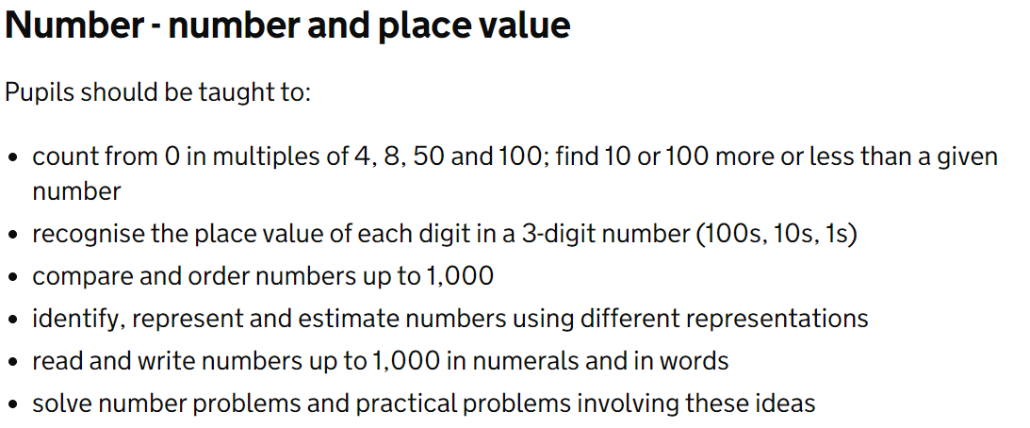
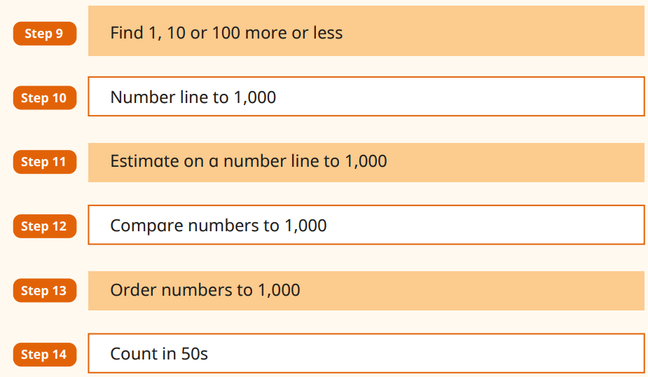
Maths Framework Y3

Slide 4
Our Maths Lessons
The White Rose Maths schemes of learning help to structure and plan our lessons. Alongside this scheme we use a range of rich resources to enhance our lessons to deepen understanding from websites such as NCETM and Nrich.
Staff deliver the maths curriculum with a focus on the concrete, pictorial and abstract approach. By using all three, children can explore, demonstrate and deepen their mathematical learning.

Slide 5
Maths at St Gregory’s Primary School
Each lesson will begin with fluency and a recap on previous learning. (Flashback four, morning activities and times table recall)
Examples of flashback 4 shared)
Fluency
Fluent in the fundamentals of maths, through varied and frequent practice with increasingly complex problems over time, so that pupils can develop conceptual understanding and the ability to recall and apply knowledge rapidly and accurately.
BUT NOT ‘rote learning without understanding’. Conceptual understanding is very important. So we should be using models and images.
Addition, subtraction, division and multiplication methods
Number bonds
Times tables

Slide 6
I will make an array using 15 counters.

Slide 7
3
5
There are _____ rows of _____
5
5
5
15
____ $+$ ____ $+$ ____ $=$ ____
3
5
15
_____ $×$ _____ $=$ _____

Slide 8
5
3
There are _____ columns of _____
3
3
3
3
3
15
____ $+$ ____ $+$ ____ $+$ ____ $+$ ____ $=$ ____
5
3
15
_____ $×$ _____ $=$ _____

Slide 9
Have a think
What do you notice?
3 $×$ 5
5 $×$ 3
5 $×$ 3 and 3 $×$ 5 are equal.

Slide 10
Have a think
What arrays can you make with these counters?
12 counters
3 rows of 4 counters.
3 $×$ 4 $=$ 12
4 $×$ 3 $=$ 12
4 columns of 3 counters.

Slide 11
What arrays can you make with these counters?
12 counters
2 rows of 6 counters.
2 $×$ 6 $=$ 12
6 $×$ 2 $=$ 12
6 columns of 2 counters.

Slide 12
What arrays can you make with these counters?
12 counters
1 row of 12 counters.
1 $×$ 12 $=$ 12
12 $×$ 1 $=$ 12
12 columns of 1 counter.

Slide 13
Have a think
What arrays can you make with these counters?
12 counters
Can you make 5 equal groups?

Slide 14
What arrays can you make with these counters?
12 counters
Can you make 5 equal groups?

Slide 18
Maths at St Gregory’s Primary School
Reasoning
Pupils can reason mathematically by following a line of enquiry, conjecturing relationships and generalisations and developing an argument, justification or proof using mathematical language.
Pupils will need to be able to discuss their ideas both verbally and through written responses.

Slide 20
Maths at St Gregory’s Primary School
Problem Solving
Pupils can solve problems by applying their maths to a variety of routine and non-routine problems with increasing sophistication, including breaking down problems into a series of simpler steps and persevering in seeking solutions.
We are developing different approaches to help pupils “see” the problem clearly so they can find a solution.
Bar Modelling
Concrete/Pictorial approaches

Slide 22
Maths at St Gregory’s Primary School
Our Curriculum
We will provide access to mathematical concepts for all children
Pupils should make connections in mathematics
Use representations to support learning
Deep rather than superficial learning – no more pushing on our able pupils but ensuring mastery and depth through reasoning.
Calculating with confidence
We teach the key number and operation skills at the start of the year to underpin the other areas of maths.
We follow the ‘mastery’ approach:
Children will master a skill so they will be fluent enough to apply in different ways and be able to explain a concept.

Slide 23
LO: Add several 1-digit numbers
Low-threshold/high-ceiling

Slide 24
Maths at St Gregory’s Primary School
Key Stage 1
The primary focus of maths teaching in KS1 is to ensure that pupils develop confidence and mental fluency with whole numbers, counting and place value. This should involve working with numerals, words and four operations, including using practical resources (e.g. concrete objects and measuring tools)
By the end of Y2, pupils should know the number bonds to 20, be precise in using and understanding place value. An emphasis on practice at this early stage will aid fluency.

Slide 25
Maths at St Gregory’s Primary School
Lower Key stage 2
Ensure that pupils become increasingly fluent with whole numbers and the four operations, including number facts and the concept of place value. This should ensure that pupils develop efficient mental methods and perform calculations accurately with increasingly large whole numbers.
By the end of Y4, pupils should have memorised their tables up to and including the x12 and show precision and fluency in their work.

Slide 26
Practising Fluency/Basic Skills
Hit the Button Maths
Squeebles
TTRS

Slide 27
Maths at St Gregory’s
Upper Key Stage 2
Ensure that pupils extend their understanding of the number system and place value to include larger integers. This should develop the connections that pupils make between multiplication and division with fractions, decimals, percentages and ratio.
By the end of Y6, pupils should be fluent in written methods for all 4 operations, including long division and long multiplication, and in working with fractions, decimals and percentages.

Slide 28
Maths at home
What you can do at home:
Encourage your children to complete their homework (remember it’s there to consolidate their learning).
Talk to your children about maths in the real world – money, time and measures.
Help them know their times tables facts (not just counting up in different amounts).
Download and print off resources and extra worksheets from the internet.
Use the methods they know, so it helps rather than confuses your children.
Refer to our website for maths calculation methods.

Slide 29
White Rose Maths at home
https://whiteroseeducation.com/parent-pupil-resources/maths/free-downloads

Slide 30
Times Tables
We learn by:
Counting up in multiples
Songs/Rhymes
Linking times tables to each other
Independent facts
Linked to division (Triangles)
Times Table Rock Stars
Hit the button
Math Fight

Slide 31
Questions

